Slide 1
Front end project hospital management system
By,
SOWNDARYA THANGAVEL

Slide 2
OBJECTIVE
The objective of the project is our mission is to bring healthcare of international standards within the reach of every individuals. To achieve, maintain the excellence in healthcare for the benefit of humanity.
MISSION : SAVE LIFE
VISION : SAVE HEART BEAT

Slide 3
introduction
Most Advanced in technology. Multi speciality Hospital. Get the best treatment. Well-equipped with state of the Art technology. Holistic Approach. Book an appointment now. World Class Treatment. Experienced Doctors. 24/7 Emergency services.
Special treatment and courses for Cardiology, Oncology, Orthopedics , Pulmonary, Uronology.

Slide 4
LANGUAGES USED
BOOTSTRAP
JAVA
SCRIPT
CSS
HTML

Slide 5
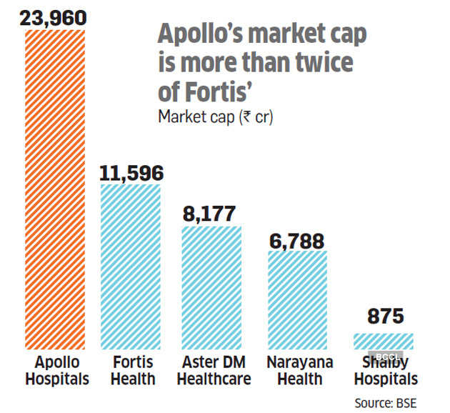

Milestone of dine fine and web awards

Slide 6


Screen shots
WELCOME PAGE ABOUTUS PAGE

Slide 7
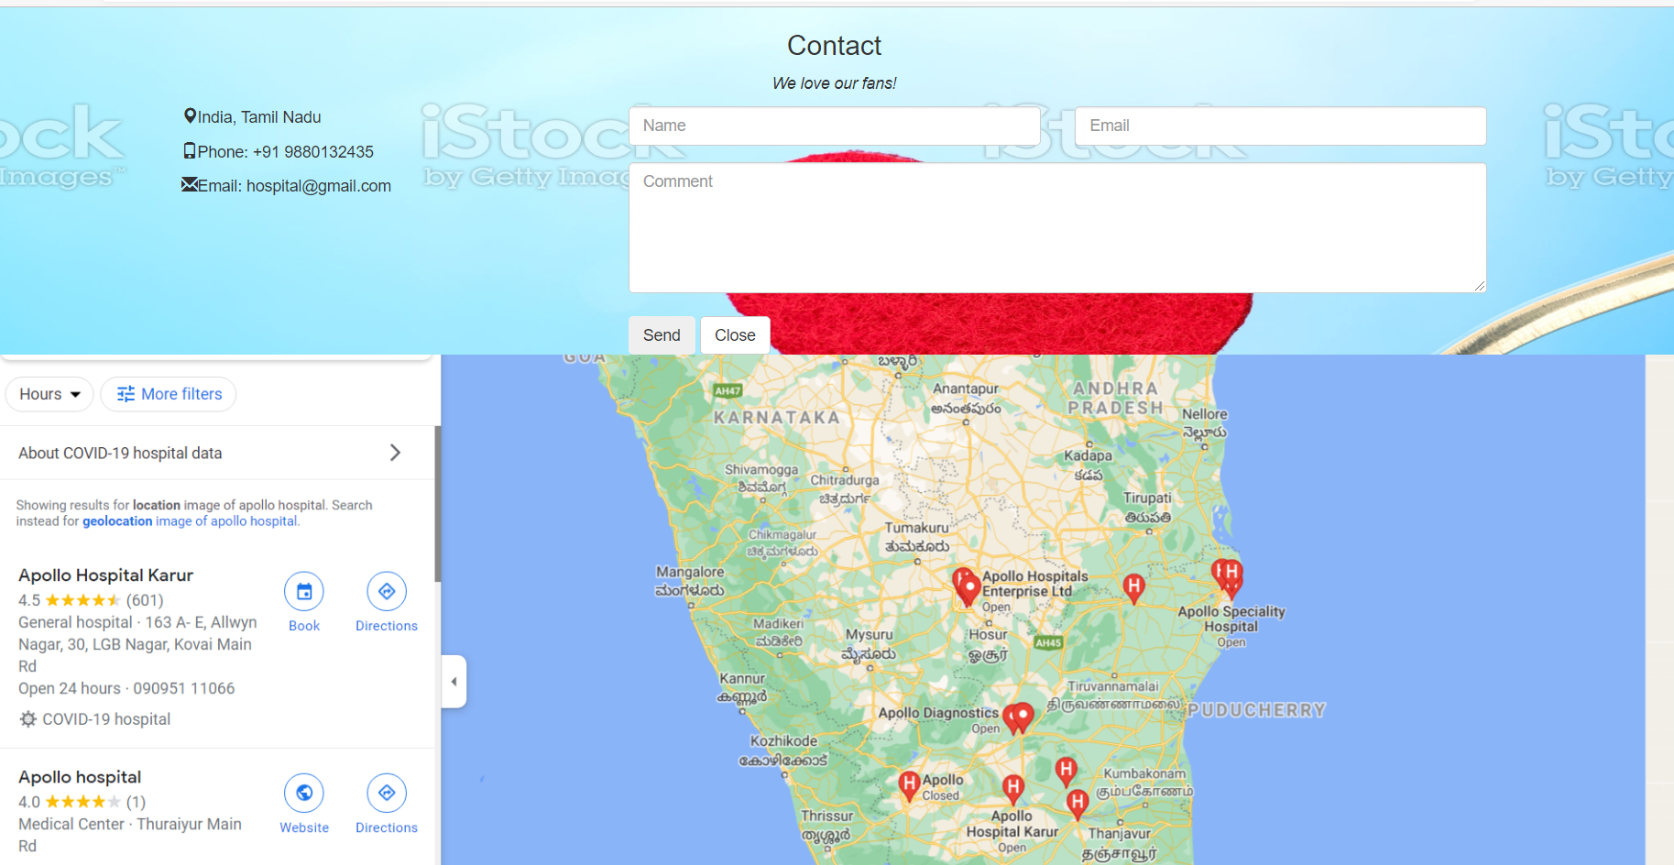
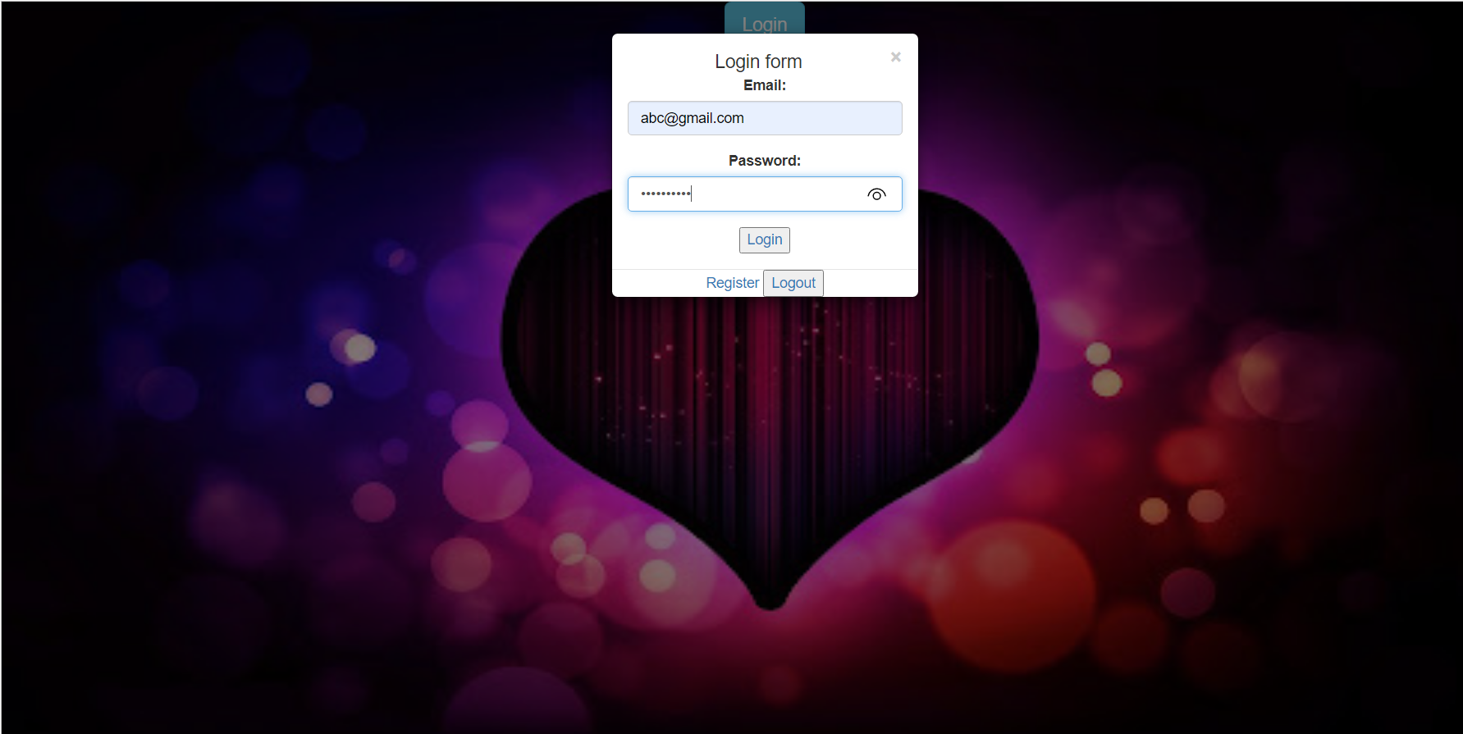
Screen shots
CONTACT PAGE LOGIN PAGE

Slide 8
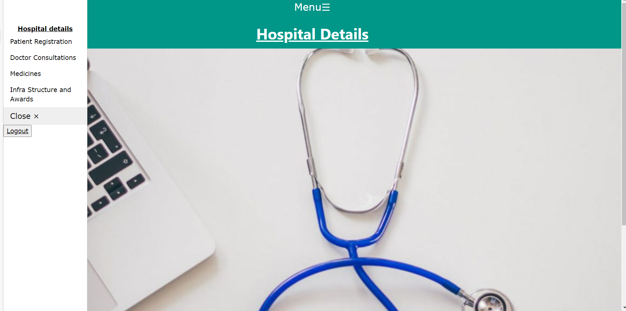
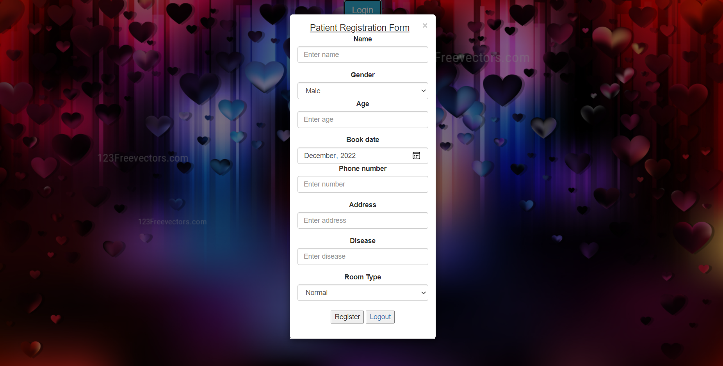
SCREEN SHOTS
MENU LOGIN FOR ROOM TYPE

Slide 9
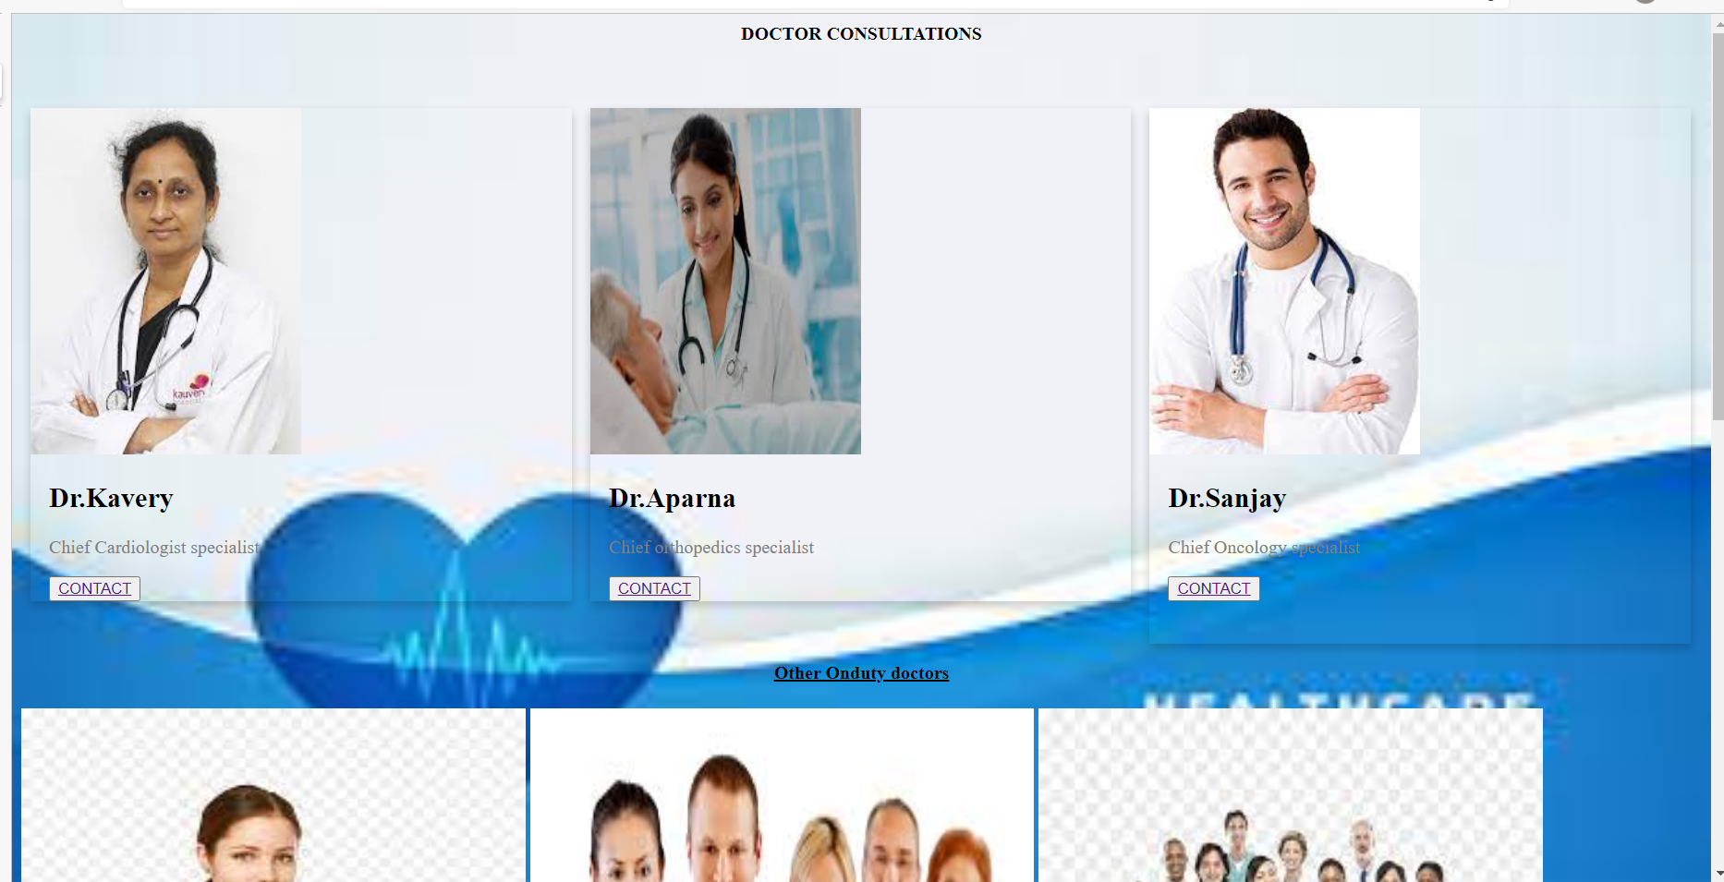
Doctor consultations

Slide 10
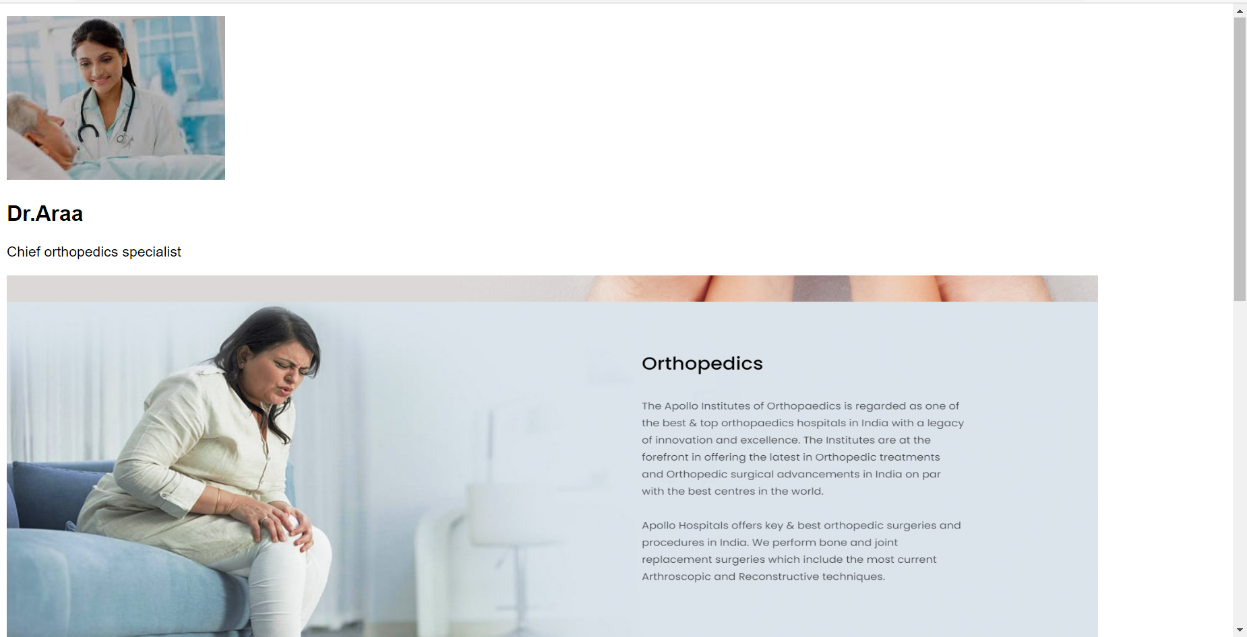
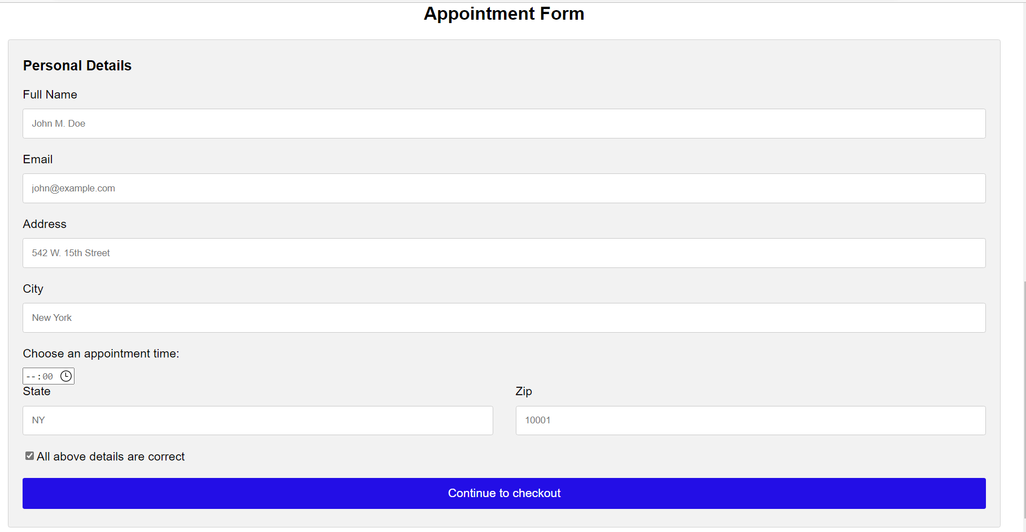
Booking appointment form

Slide 11




Online Courses

Slide 12
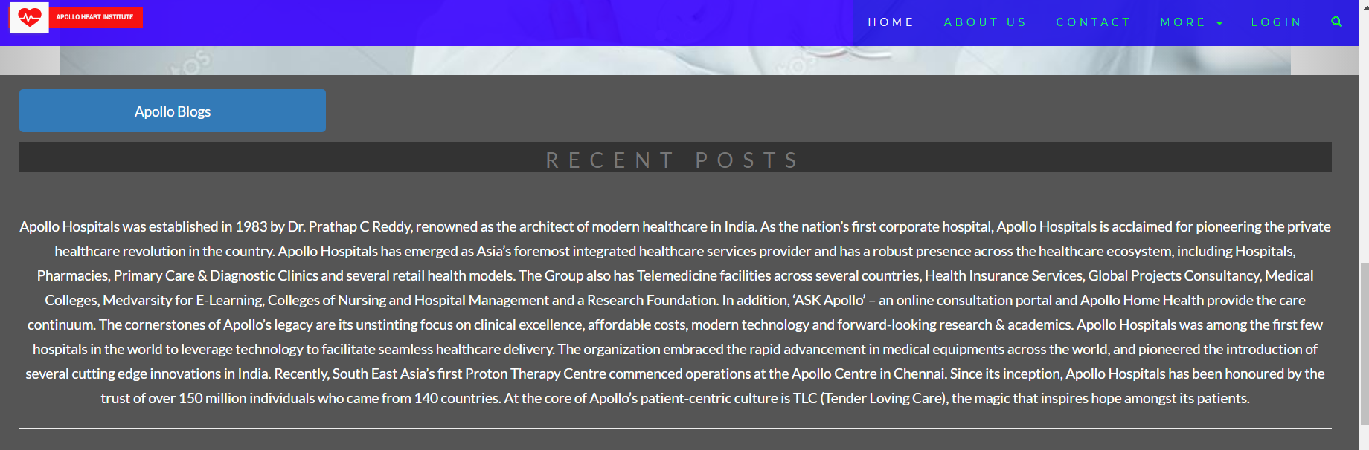
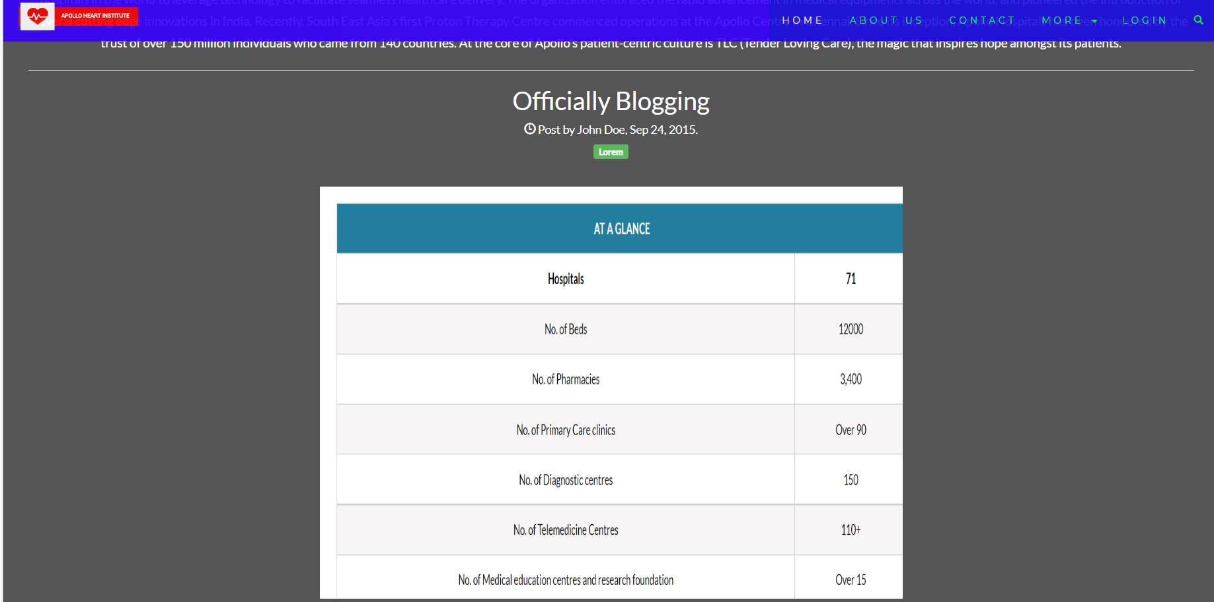
blogs

Slide 13
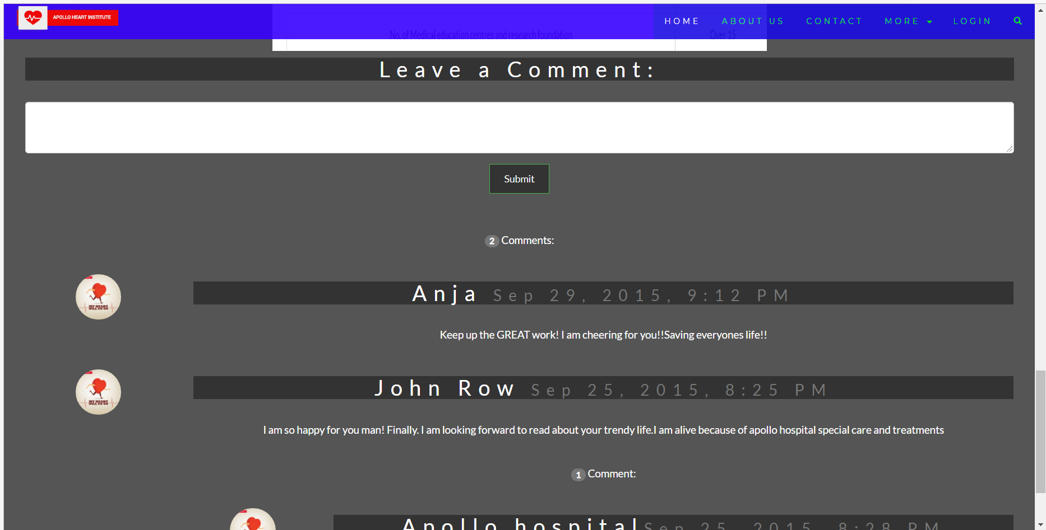
Comments section

Slide 14
Thank you

